Slide 1
KWAME NKRUMAH UNIVERSITY OF SCIENCE & TECHNOLOGY COMPUTER ENGINEERING 3 COE 352: INTRODUCTION TO SOFTWARE ENGINEERING PROJECT PRESENTATION ON E-COMMERCE APP: INSTASHOP

Slide 2
VORTECH GROUP MEMBERS
YOOCEE DIRENTWI ANSAH (3579818)
VALDO ATO KEKEKI ABRUQUAH (3577318)
KIRSTON KWASI-KUMAH (3584418)
MARK TANTUO (3589018)
BEATRICE MANKO ASIHENE (9340817)
HEZZY PAAPA YEBOAH BOADU (3589918)
EUGENE OSEI-ADJAPONG (3586518)
STEPHON KWAME BOAPEAH (3591018)
YEMO SYLVESTER (3588518)

Slide 3
INSTASHOP

Slide 4
ABOUT APP
InstaShop is an e-commerce mobile application software that was designed to meet online shopping needs of small-scale businesses as well as cater for vendors who intend to run an online business. It has a user-friendly UI and hence is very easy to operate. It was developed using flutter, dart, MySQL, python, flask and SQLite3. Some features of the app include friendly registration page, comprehensible categorization of selling items, wishlist, option to add to cart, settings page amongst others.

Slide 5

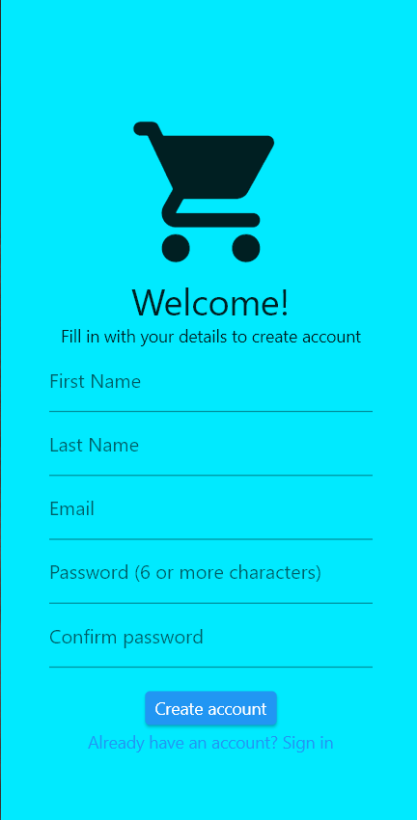
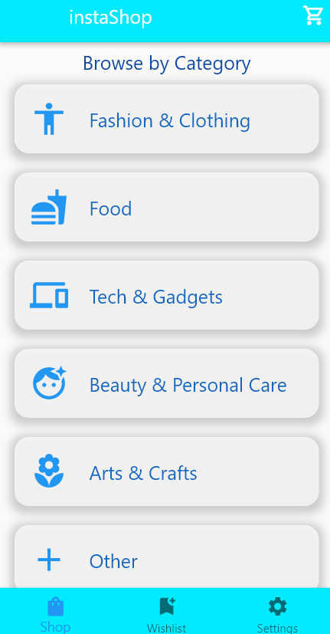
APP FORMAT PICTURES
Welcome Page Registration Page Category Page

Slide 6
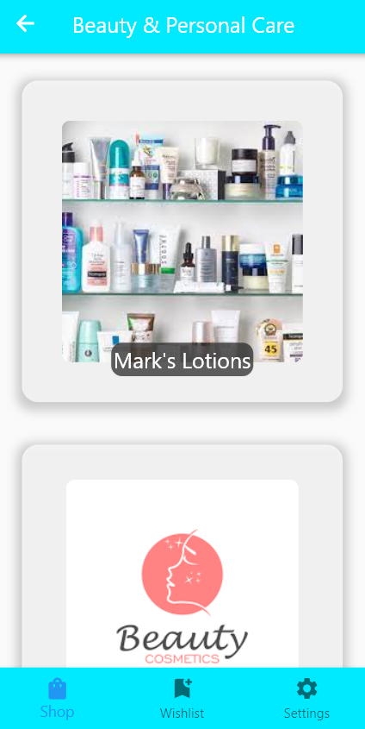
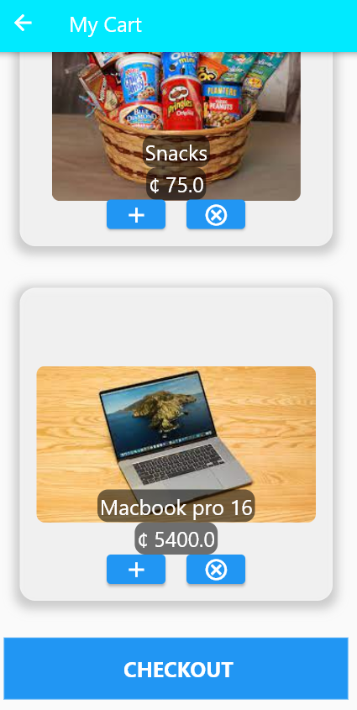

Item Purchase Page Cart Page Account Details Page

Slide 7
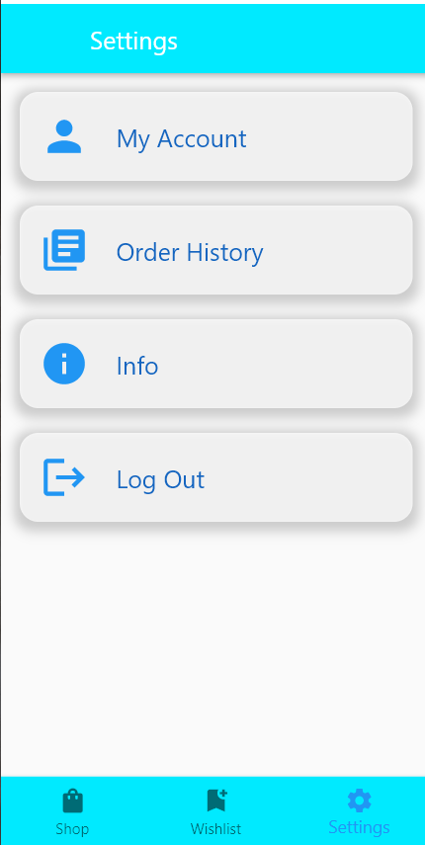
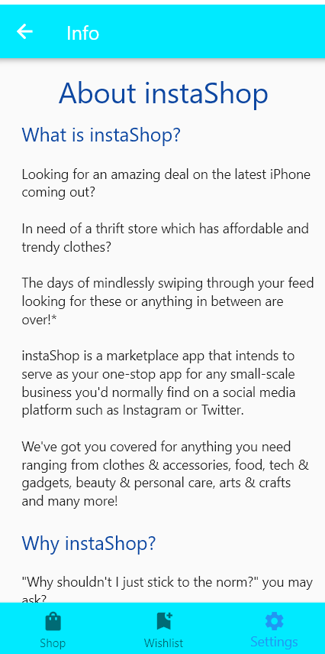
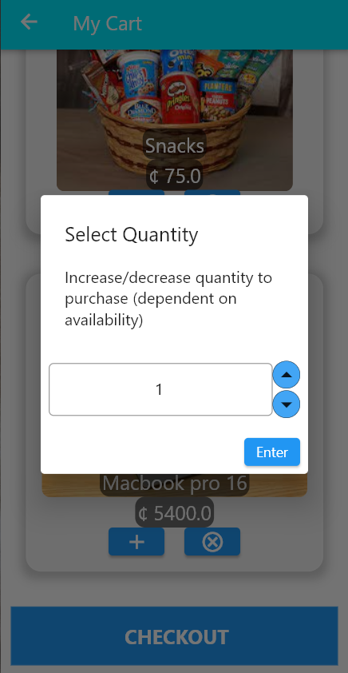
Settings About Quantity of Purchase

Slide 8
INCEPTION (THE PROBLEM)
The need for the app arose upon realization that most student vendors had no proper online platform to sell their products apart from social media, which is used for way more than just selling items. It may also take forever for a user to come across a page that sells items on social media. The idea was to create a platform strictly for buying and selling of items, especially for the needs of students. This makes it easier with the uniformity that comes with such a platform.
Owing to this, we conducted an online survey to know if students would welcome the idea of such an app being made available to them. Here, amongst other questions, are the results of the survey:

Slide 9
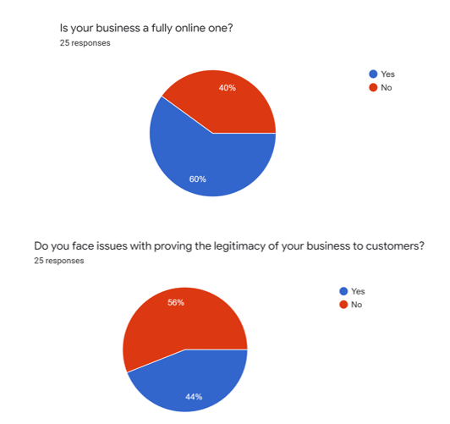

Slide 10
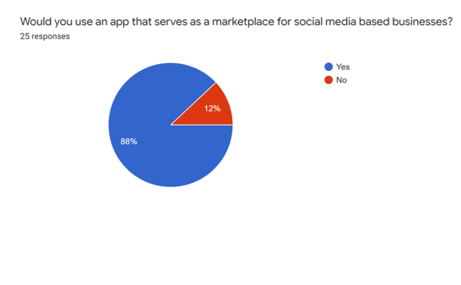

Slide 11
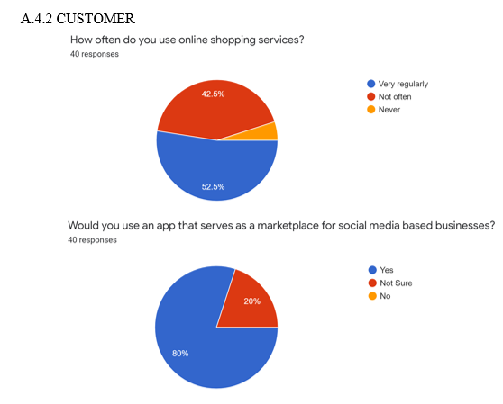

Slide 12
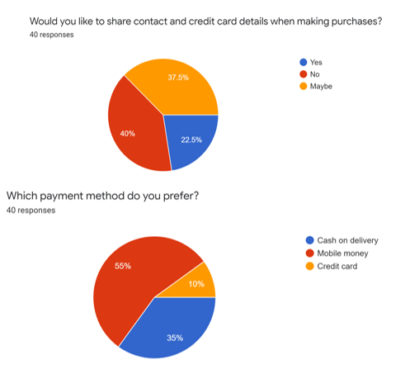

Slide 13
PURPOSE OF THE APP (THE SOLUTION)
In short, the purpose of the app was to create a uniform online platform that was solely for the purpose of enhancing online businesses, especially that of students and make it easier for said target group to be able to do buying and selling of items online.

Slide 14
CONCLUSION
Based on the problem identification process and the findings of our survey, we believe we have come up with a viable solution – InstaShop. A simple but convenient mobile app designed to meet the online shopping needs of students.

